Slide 1



Introduction to Economics
BSIT 5 semester
Topic:
Teacher name:
The circular flow model
Fizza Shaukat
Lecture 1 and 2

Slide 2
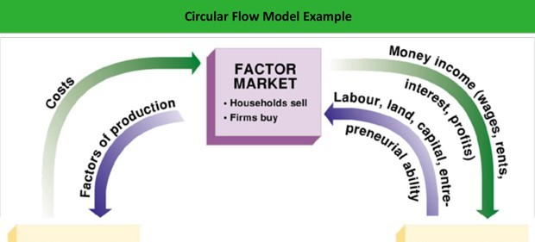
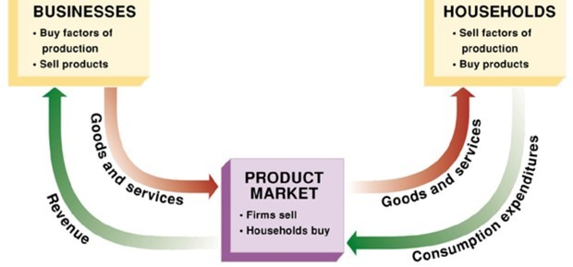

Slide 3
House Hold
House holds are the individual in a country, live in the country.
 A household consists of one or more people who live in the same dwelling and share meals. It may also consist of a single family or another group of people
They are consumer and resource ( labour) or other.

Slide 4
Firm
Business where things are produced.
 A firm is a commercial enterprise, a company that buys and sells products and/or services to consumers with the aim of making a profit.
 A business entity such as a corporation, limited liability company, public limited company, sole proprietorship, or partnership that has products or services for sale is a firm.

Slide 5
Product market
 Where buyer and seller communicate together. The things that are produced by the firm are sold in product market to the house hold.
 The product market is the market place where final goods and services are sold to businesses and the public sector. Focusing on the sale of finished goods, it does not include trading in raw or other intermediate materials.

Slide 6
Factor market
Resources must be used in the production process to produce goods and services. Resources are also called factors of production.The major factors are
(1) Land
(2) Labour
(3) Capital
(4) Organization.
 Individual go to the Product market to buy things (spending) they gave money to the product market, that money is than go to the firm in the form of revenue.The firm don't keep all his money , the spend that money to resource market in the form of wages/salaries (FoP).Thus money goes to household in the form of income.
This is the monetary flow
 House hold provide labour resource to factor market and in exchange they are getting income. So the labour and resource go to factor market from factor market the labour and resources find the way ultimately to the firm itself.The firm need labour resource to produce things, those thing which we called products (goods/Services) who make there way to Product market so Factor/firm send the product to store/market, those things find the perspective buyer they finally go to household/producers.

